Slide 1
Leuvenair.be
A citizen project for mapping air quality in Leuven at high spatial and temporal resolution
Maarten Reyniers
Kris Vanherle, Frans Fierens, Walter Op de Beeck, Bert Cornillie, Wouter Florizoone, Geert Vanhorebeek, Lieven Vandegaer, Linde Vloeberghs, Wim Van de Velde, Dries Van Ransbeeck

Slide 2
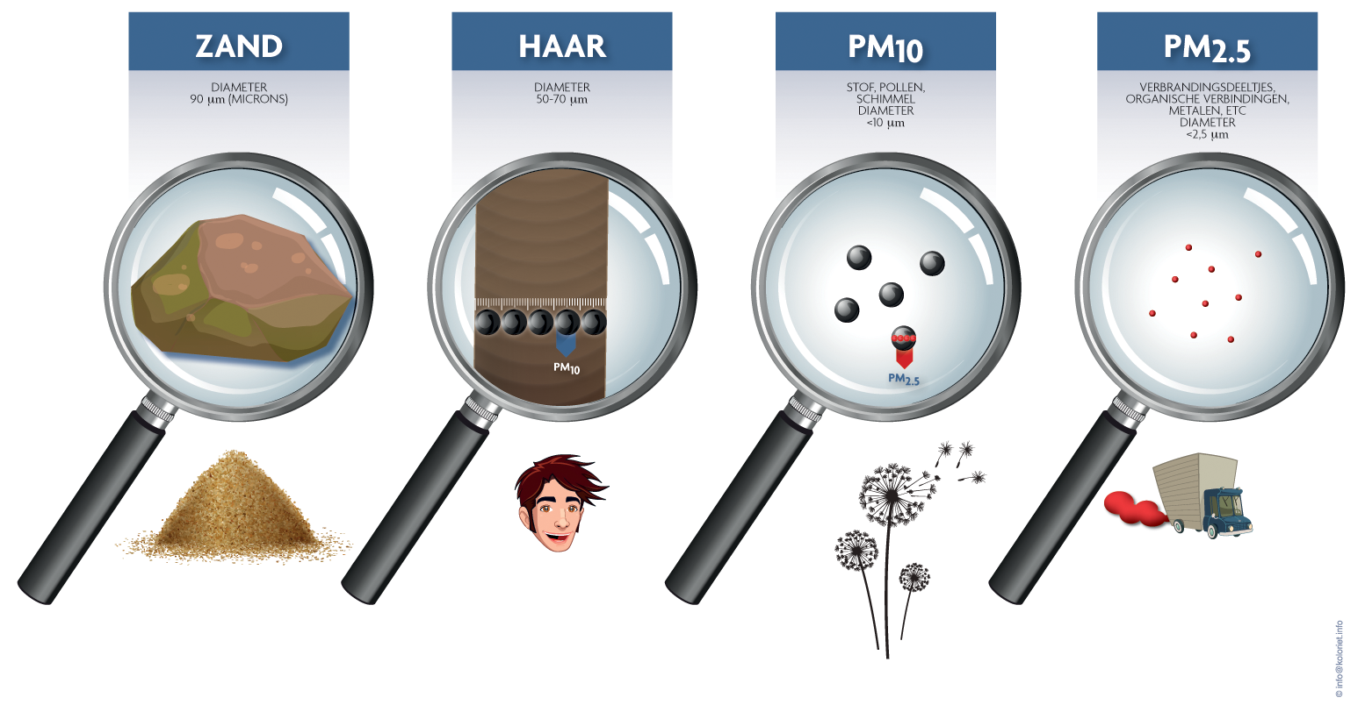
What is Leuvenair.be?
= a citizen project to map air quality in Leuven with low-cost sensors
We measure particulate matter PM2.5 and PM10
Notes:
Luchtkwaliteit is een complexe materie en fijn stof is één aspect van luchtkwaliteit (naar gezondheid toe wel de belangrijkste).
Ultrakleine partikeltjes die in de lucht zweven. Fijn stof heeft verschillende oorzaken.

Slide 3
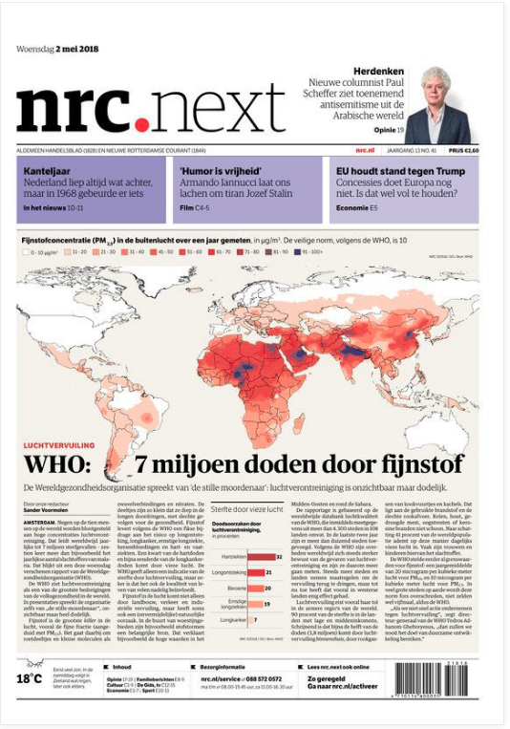
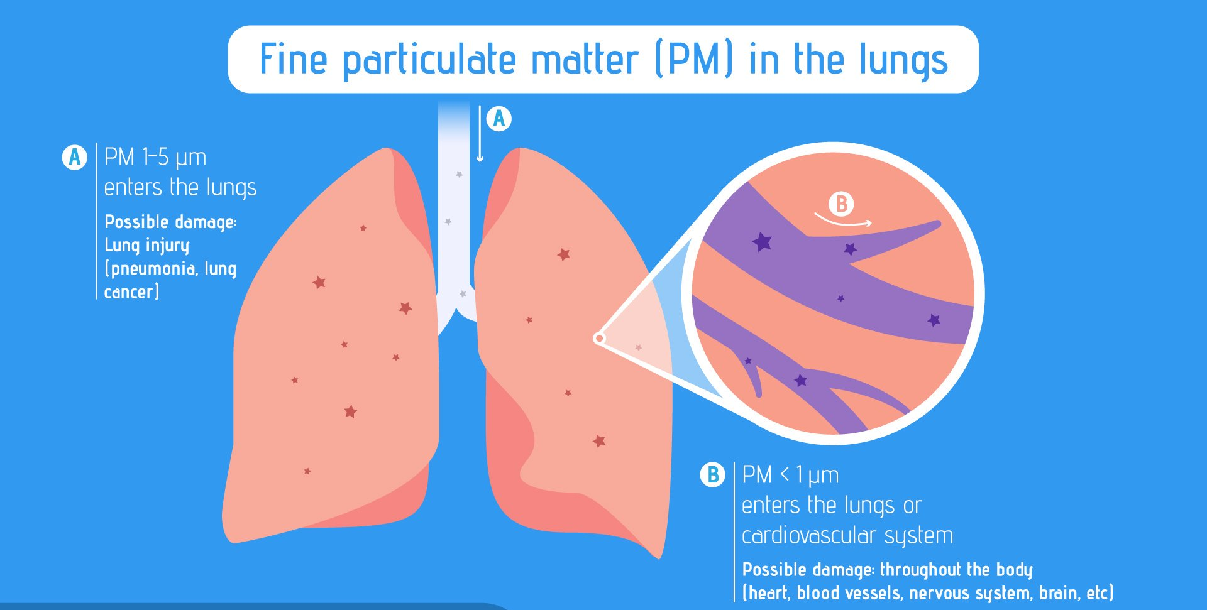
What is Leuvenair.be?
= a citizen project to map air quality in Leuven with low-cost sensors
Notes:
”Fijn stof in kaart brengen”, dan bedoelen we ook werkelijk een kaart.

Slide 4
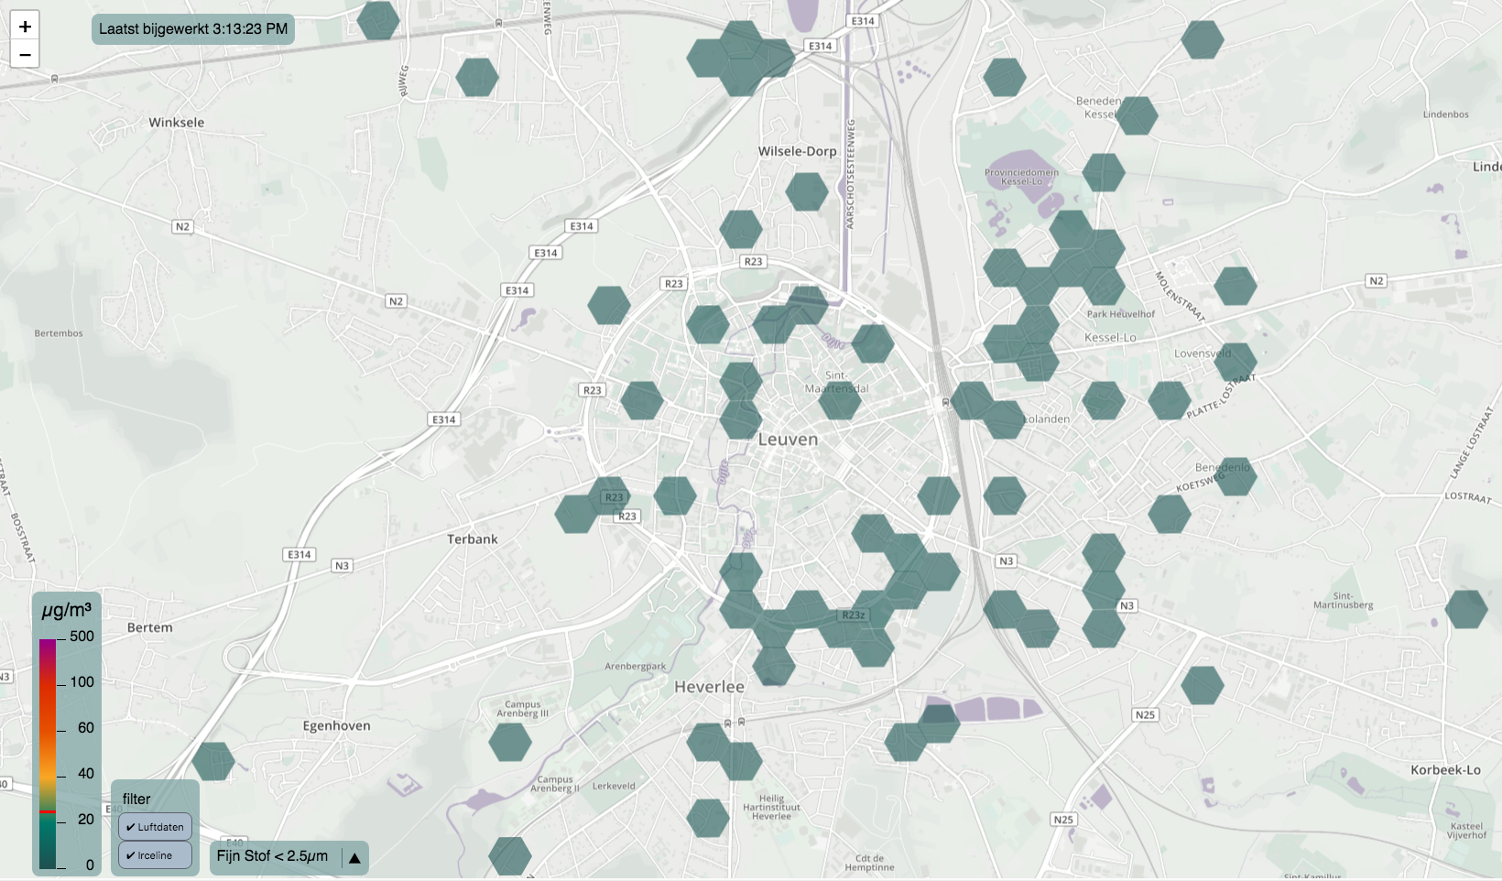
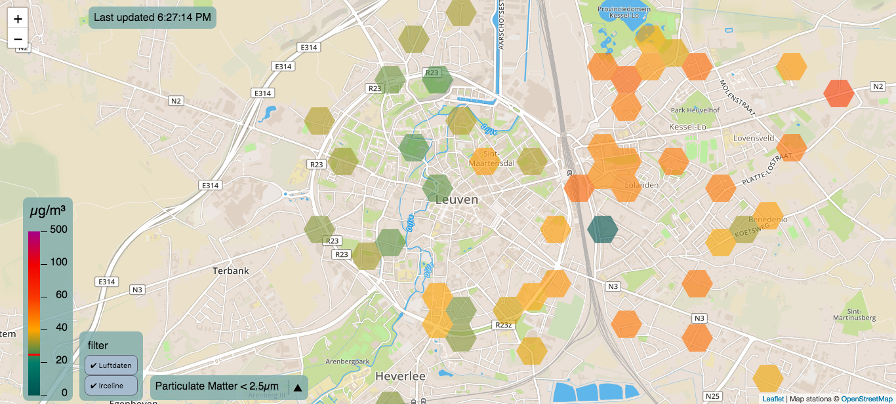
What is Leuvenair.be?
= a citizen project to map air quality in Leuven with low-cost sensors
Notes:
”Fijn stof in kaart brengen”, dan bedoelen we ook werkelijk een kaart.

Slide 5
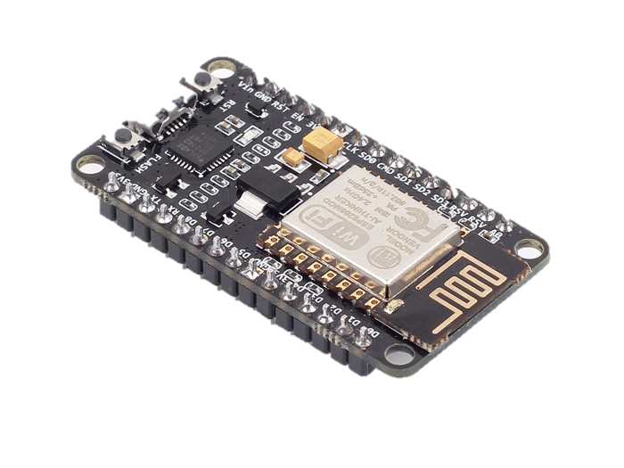
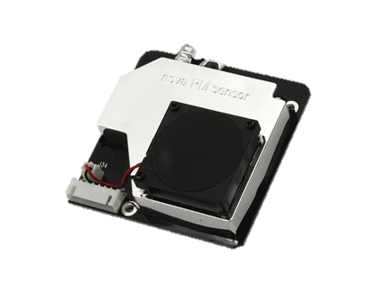
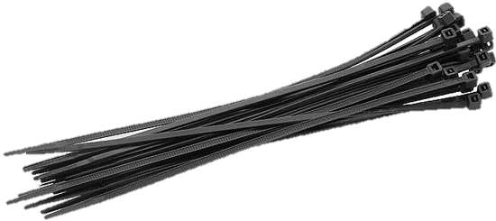
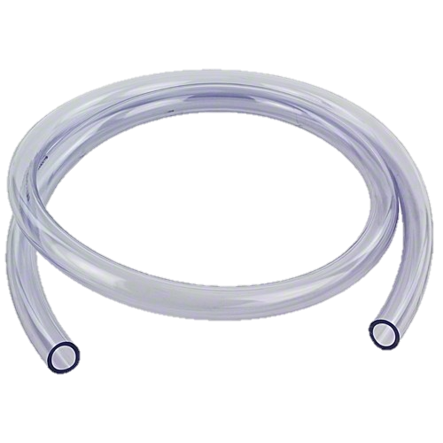
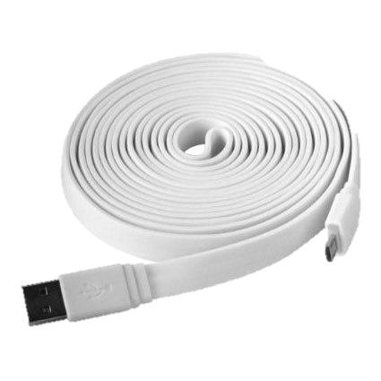
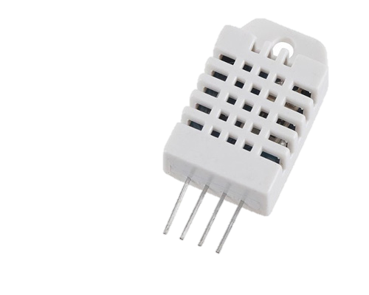
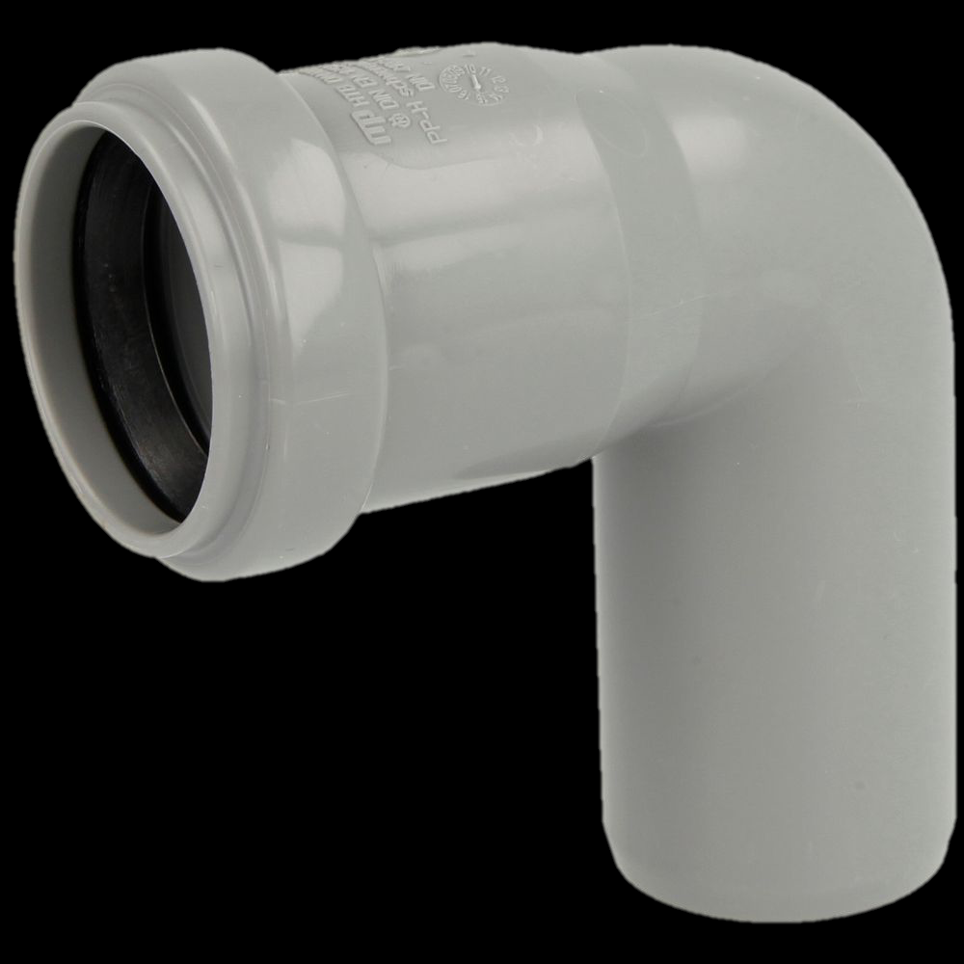
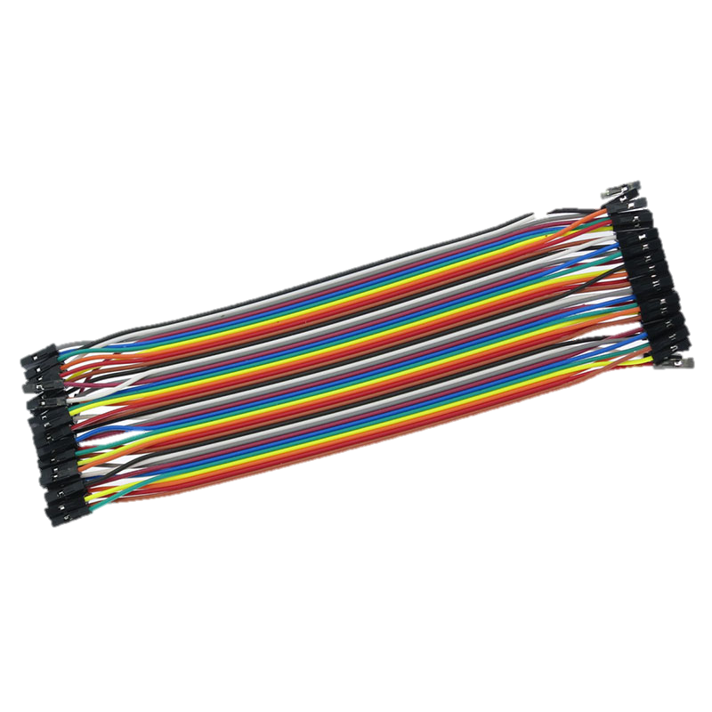
What is Leuvenair.be?
= a citizen project to map air quality in Leuven with low-cost sensors

Slide 6
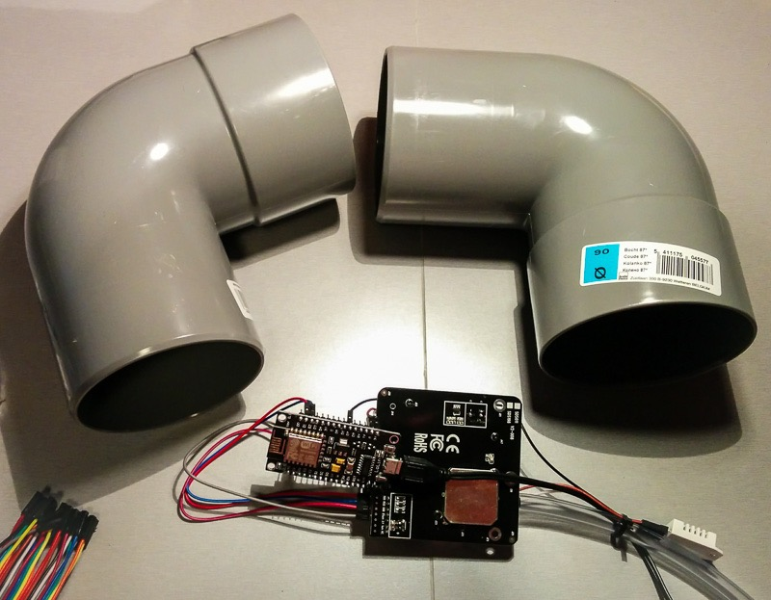
What is Leuvenair.be?
= a citizen project to map air quality in Leuven with low-cost sensors

Slide 7
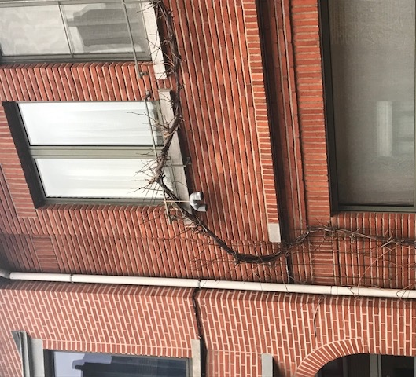
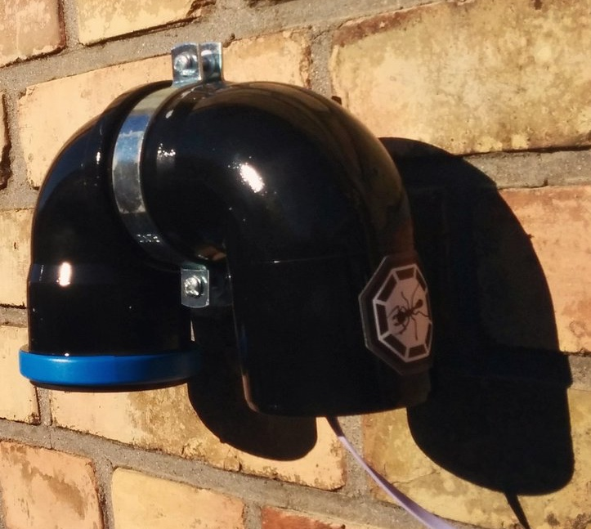
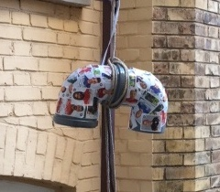
What is Leuvenair.be?
= a citizen project to map air quality in Leuven with low-cost sensors

Slide 8




What is Leuvenair.be?
= a citizen project to map air quality in Leuven with low-cost sensors
personal initiative
existing platform
supported by
Luftdaten.info
Firmware for device
Central database
purchase of 100 sensors with subsidy of Province
registration of participants

Slide 9
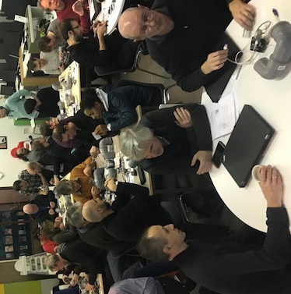
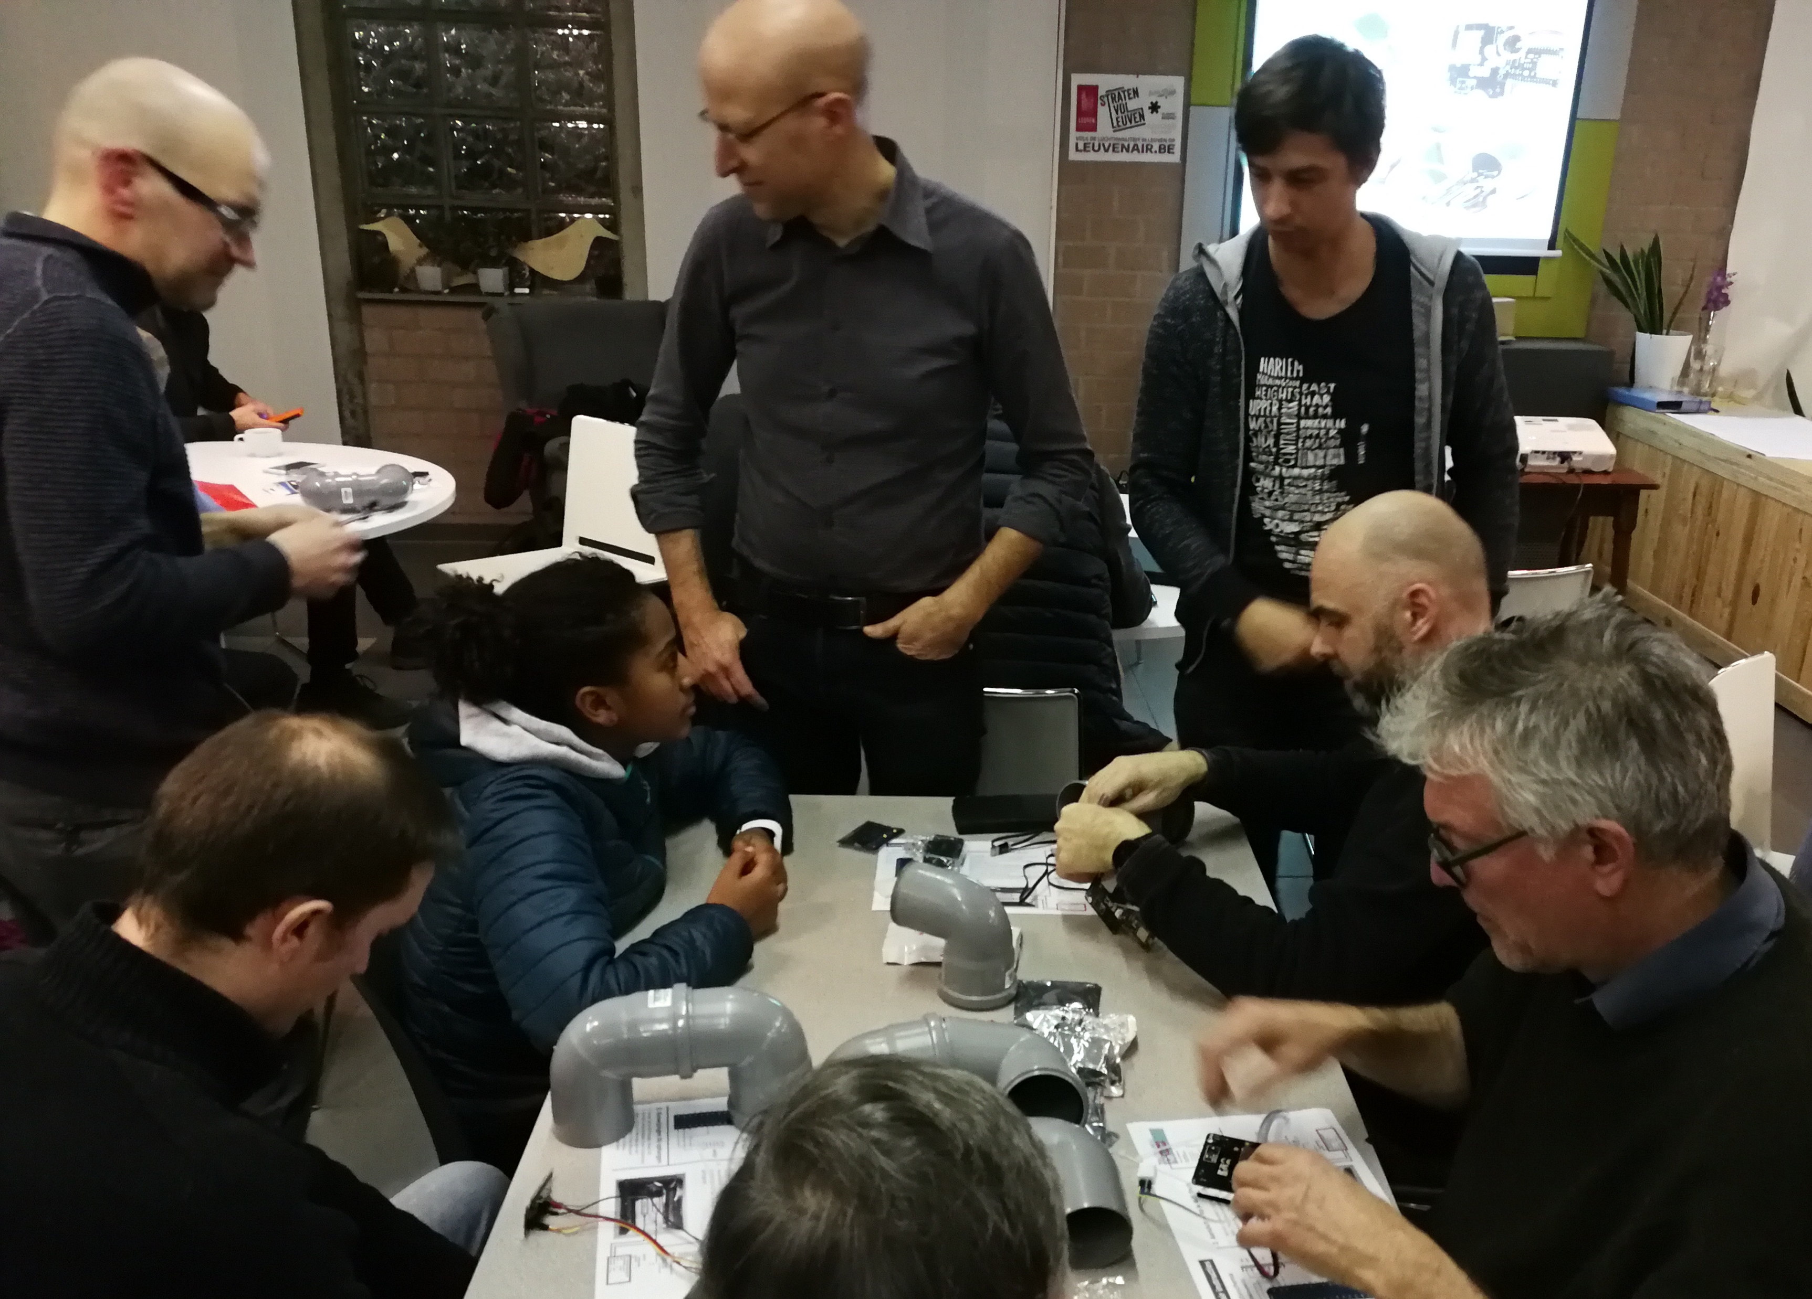
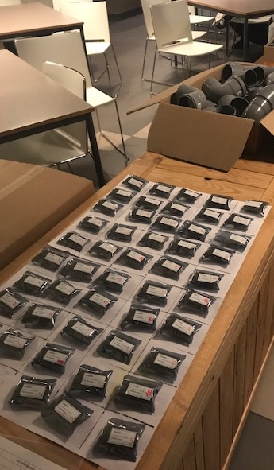
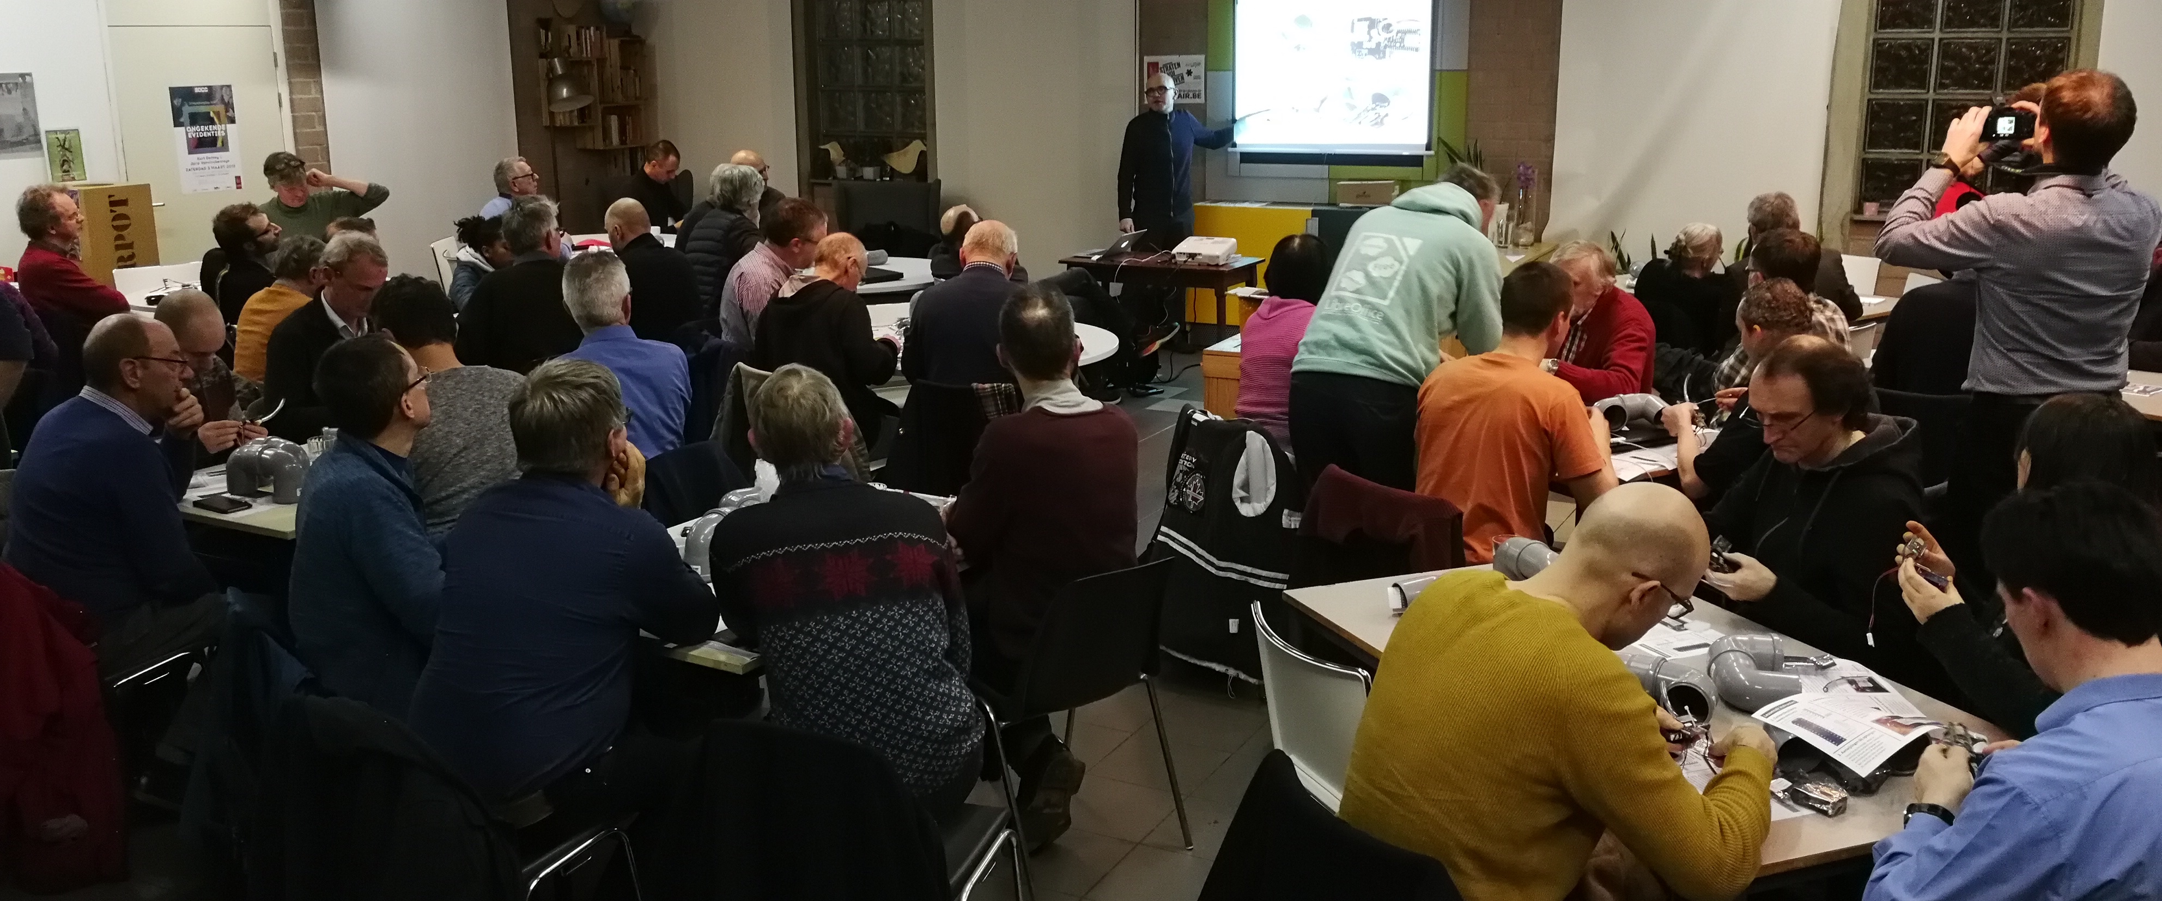
What is Leuvenair.be?
= a citizen project to map air quality in Leuven with low-cost sensors

Slide 10
What is Leuvenair.be?
= a citizen project to map air quality in Leuven with low-cost sensors

Slide 11
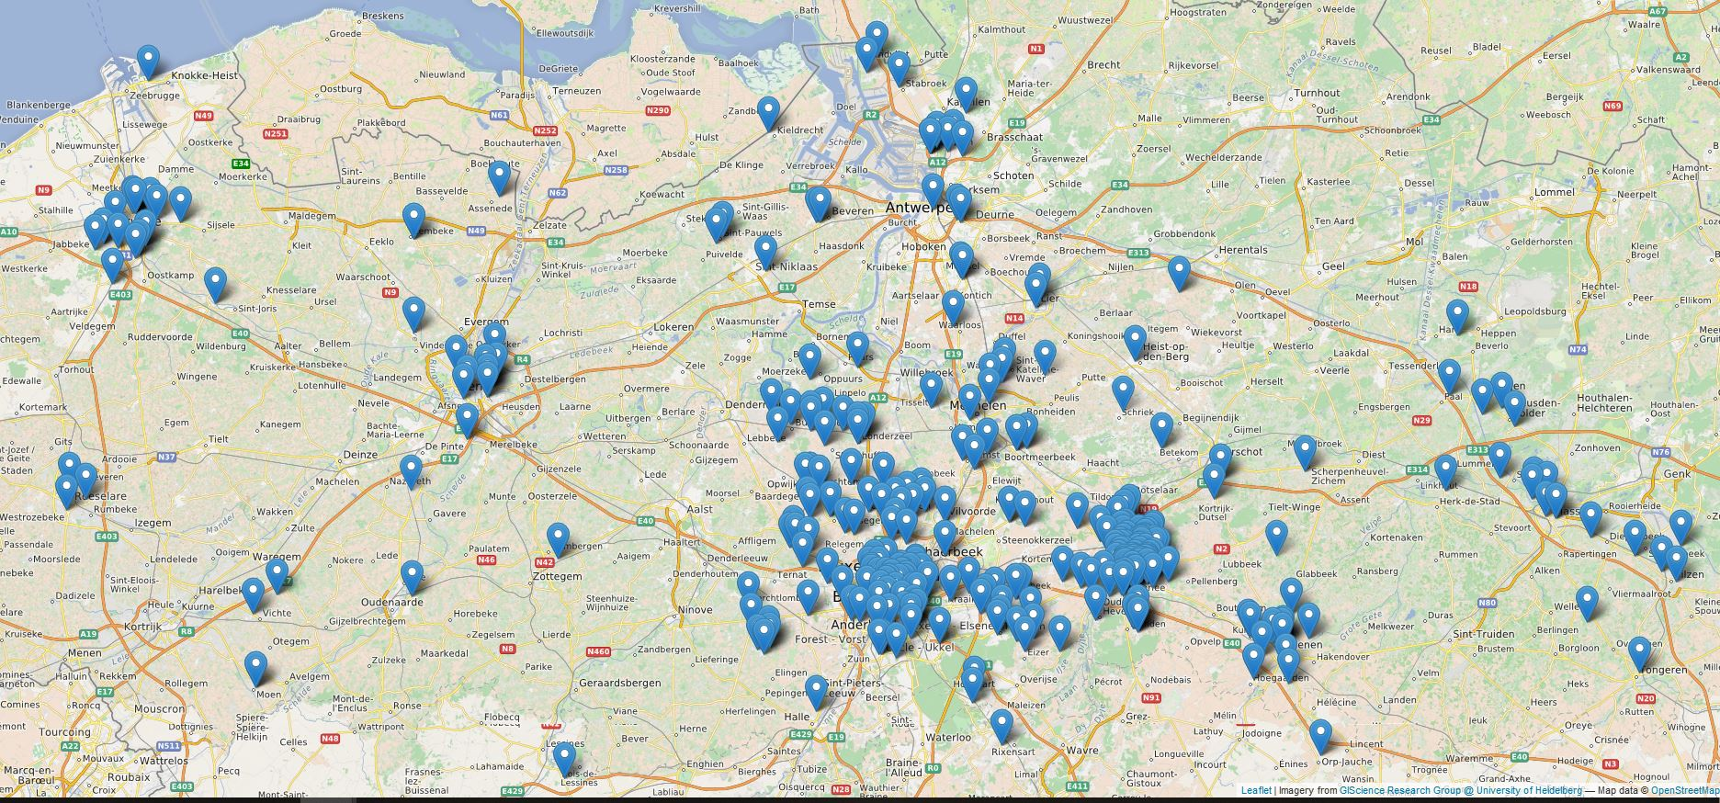
The Luftdaten.info platform
Initiatives in Flanders and Brussels
Influencair
Fijn stof in de Rand
Wase Lucht
dustCube (Deurne)
AiRsl (Roeselare)
Luchtpijp (Beweging.net)
Also in Kortrijk, Hasselt, Brugge, Gent, Tienen,…
Kaart: Lode Demey, stad Roeselare

Slide 12
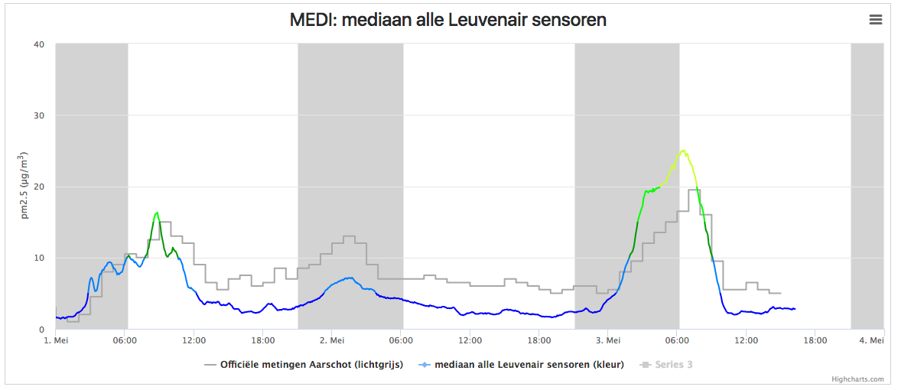
What did we detect so far?
General “background” of particulate matter which is quite uniform over Leuven

Slide 13
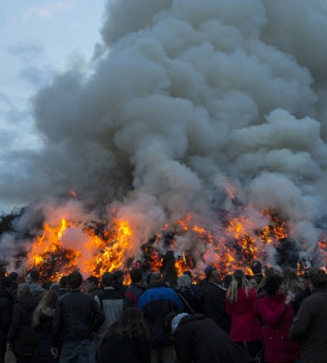
What did we detect so far?
General “background” of particulate matter which is quite uniform over Leuven
“Easter bonfires” in NL en DE (01/04/2018)

Slide 14
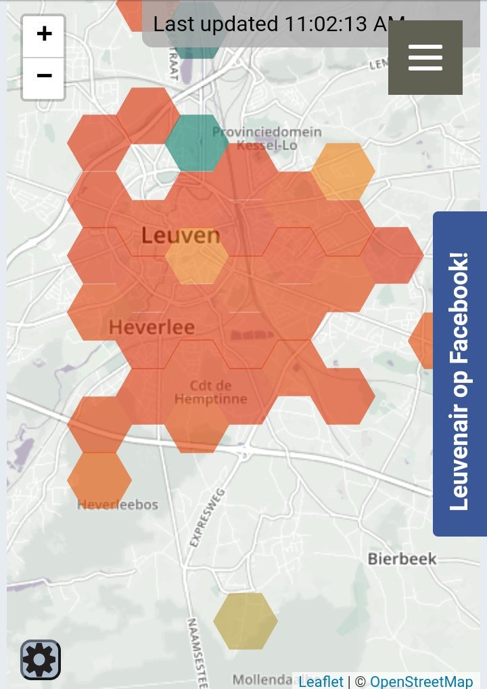
What did we detect so far?
General “background” of particulate matter which is quite uniform over Leuven
“Spring smog” (20-21/04/2018)
Foto: @BartVndnbussche

Slide 15
What did we detect so far?
Very local effects (primary particulate matter)
- Neighbours party with fire pits

Slide 16
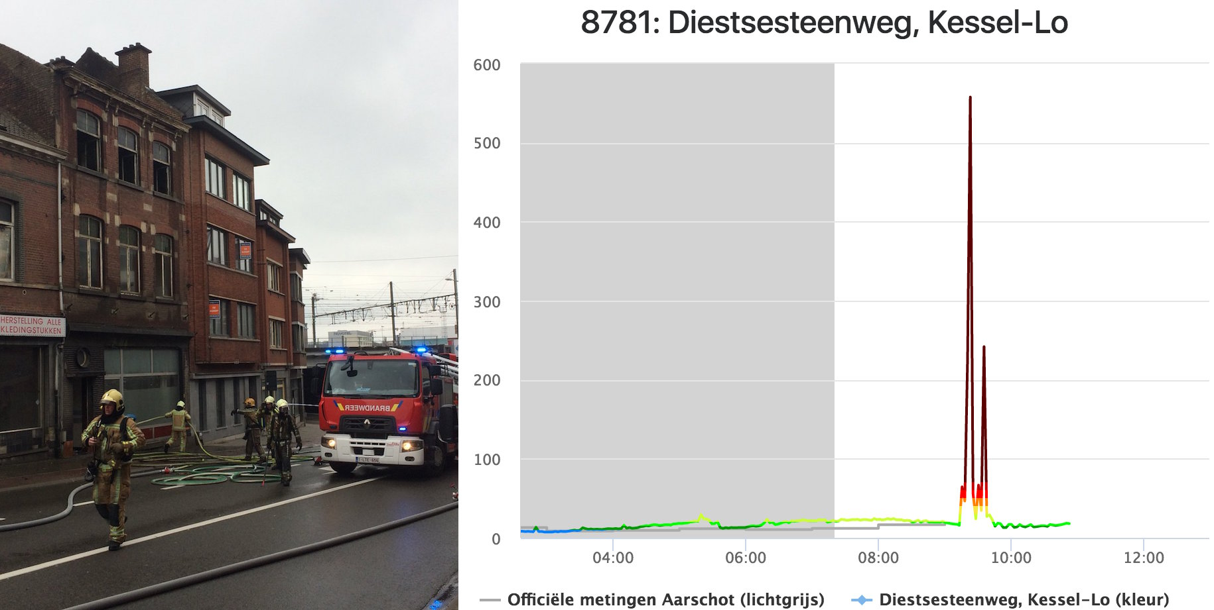
What did we detect so far?
Very local effects (primary particulate matter)
- Several house fires, e.g. 01 April 2018
Foto: @PolitieLeuven

Slide 17
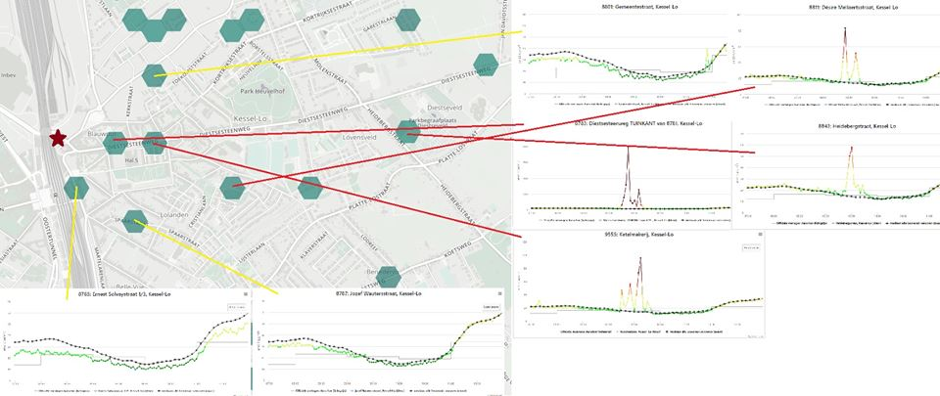
What did we detect so far?
Very local effects (primary particulate matter)
- Several house fires, e.g. 01 April 2018
Kris Vanherle

Slide 18
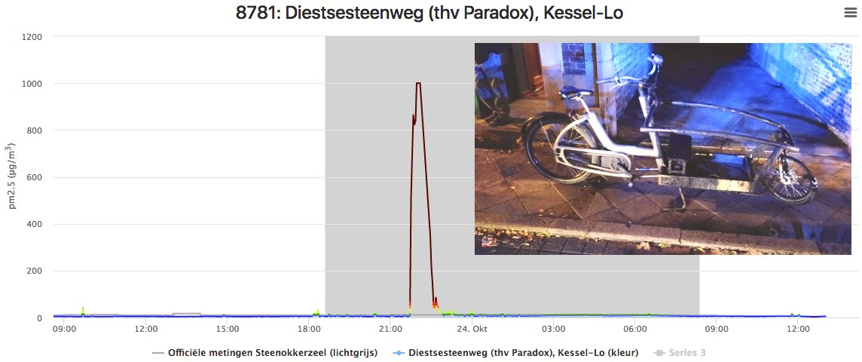
What did we detect so far?
Very local effects (primary particulate matter)
- Ignition of cargo bike battery of one of our participants

Slide 19
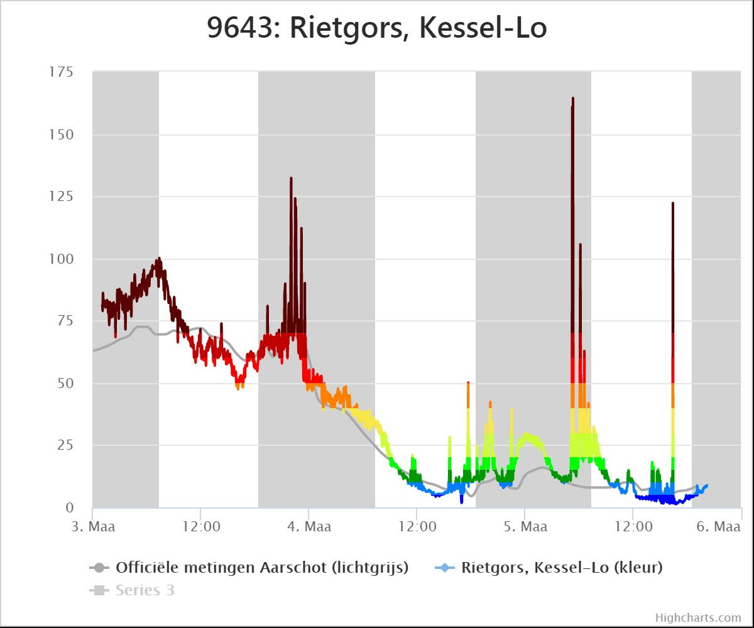
What did we detect so far?
Very local effects (primary particulate matter)
- Areas with a high concentration of wood stoves

Slide 20
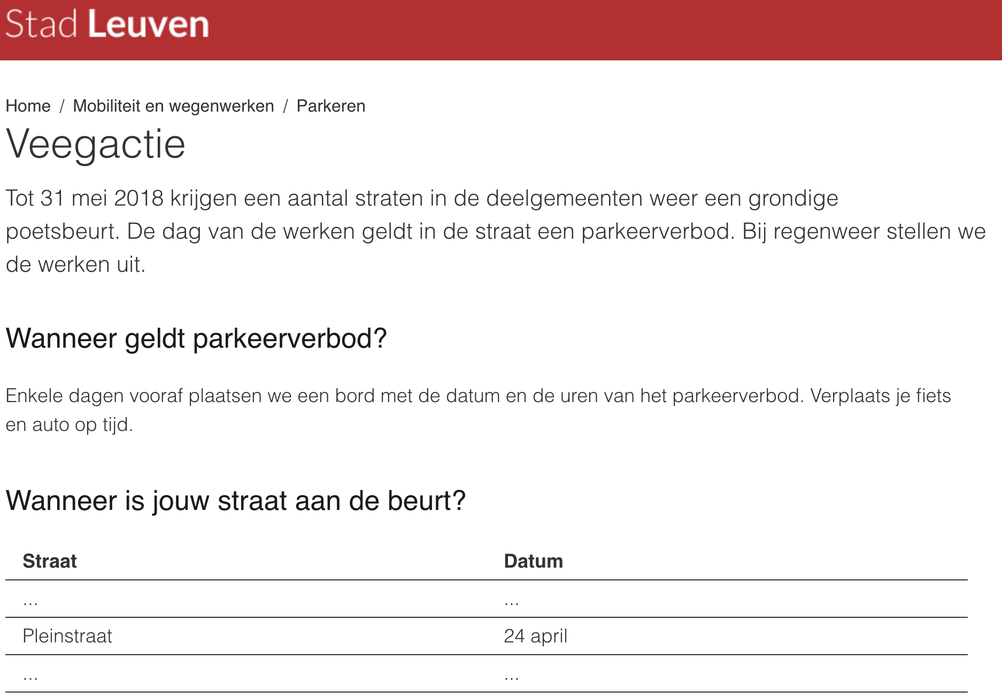
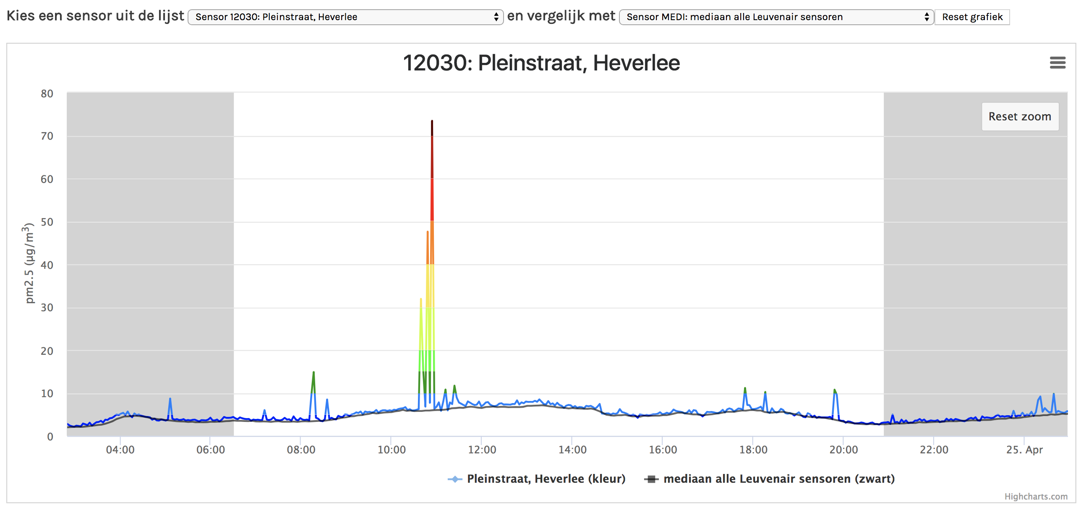
What did we detect so far?
Very local effects (primary particulate matter)
- Municipal cleaning action in the street

Slide 21
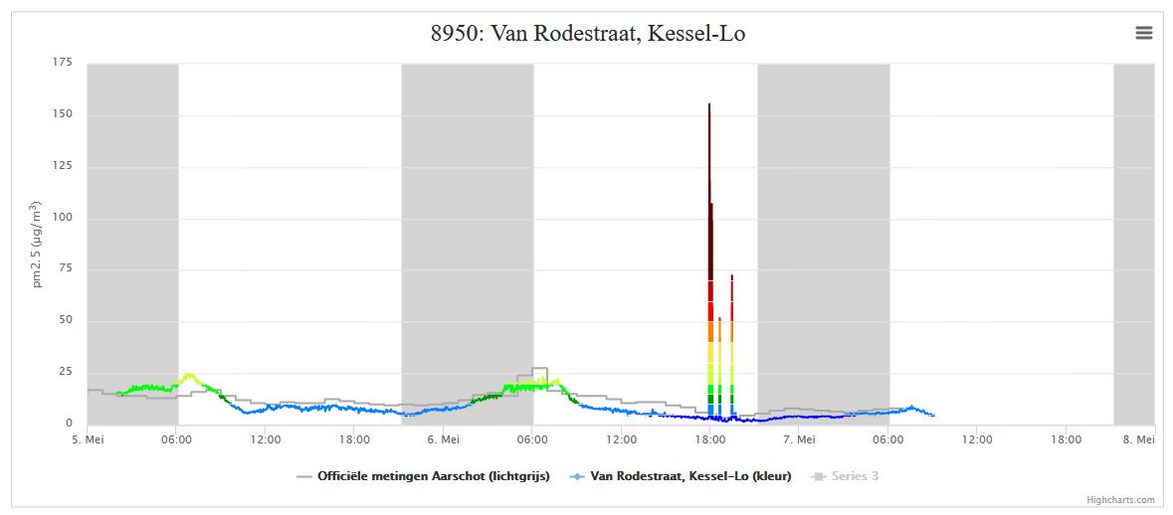
What did we detect so far?
Very local effects (primary particulate matter)
- The neighbour’s barbecue

Slide 22
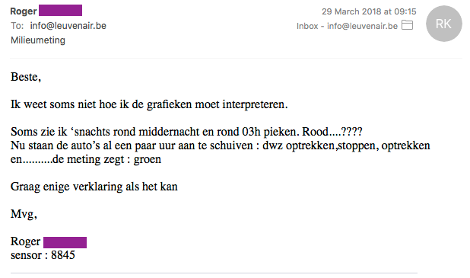
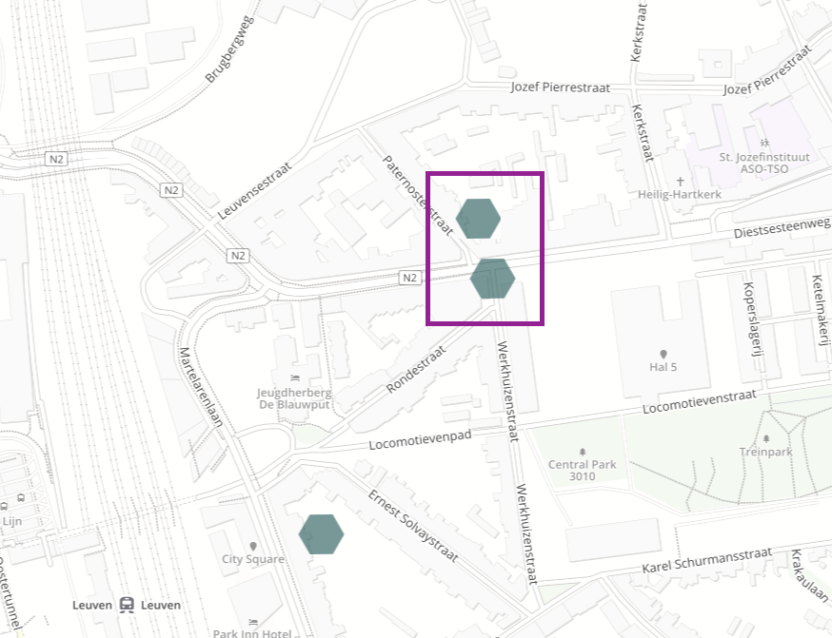
What did we detect so far?
And what about traffic?
Garden side: 12.2 µg/m³
Street side: 10.4 µg/m³
(mean)

Slide 23
What did we detect so far?
General “Background” of particulate matter which is quite uniform over Leuven
Very local effects (primary particulate matter)
→ We have only some “data stories” up to now

Slide 24
DATA CHALLENGES – some ideas
Sensor is known to overestimate in humid conditions (RH>75%) and underestimate in very dry conditions (RH<40%), but also temperature can play a rol → characterise dependency and come up with a correction method
How to deal with intrinsic sensor-to-sensor variability
Are there areas in Leuven that show a systematic higher pollution than others? Can this be linked to traffic, to agricultural activities?
Identify areas with high concentration of wood stoves (peaks in winter during evening/night)
Is there any indication that there is more PM in areas with heavy traffic?
Develop a valuable method for real-time interpolation (+ how to handle instantaneous peaks)

Slide 25
Leuvenair – a success story!
“Citizen engagement” was really overwhelming
Accuracy PM measurements exceeds expectations (but also problems!)
Interest from media and local and regional authorities is encouraging
Leuvenair – lessons learnt
No funding at this moment
Expectation that participating citizens would also start to analyse the data is not fulfilled
“Expectation management” is very important

